Slide 1
Microbial Biotechnology
BT431
Fermentation

Slide 2
Fermentation: Multiple definitions
Any process involving the mass culture of microorganisms, aerobically or anaerobically
Any biological process that occurs in the absence of oxygen
Spoilage of food
The production of alcoholic beverages

Slide 3
Microbial growth kinetics
Sanjai Saxena, Applied Microbiology

Slide 4
Lag phase
Cells are adapting to environment
Intense metabolic activity (DNA and enzyme synthesis)
Cell growth is minimal in this phase.

Slide 5
Log phase
Cell division (logarithmic increase or exponential increase)
Generation time is constant = log plot of growth is a straight line.
Most metabolic activity (catabolism and anabolism)
Cell is sensitive to adverse conditions (antibiotics, changes in environmental factors)

Slide 6
Stationary phase
The number of cells multiplying equals the number of cells dying
Lack of nutrients, accumulation of waste products, pH changes.
Net growth rate is zero
Cells still active and produces the secondary metabolites..

Slide 7
Death phase and the extended death phase
Number of dying cells > number of dividing cells
Can be a logarithmic decrease
Depending on the species, some cells can survive long periods of time and thus show a successive waves of growth and death.

Slide 8
Phases of fermentative production process
Upstream process
Fermentation
Downstream process

Slide 9
Phases of fermentative production process

Slide 10
Inoculum preparation

Slide 11
Phases of fermentative production process

Slide 12
Phases of fermentative production process
Sanjai Saxena, Applied Microbiology

Slide 13
Fermenters (Bioreactors)
Sanjai Saxena, Applied Microbiology

Slide 14
Fermenter control and monitoring
Industrial Microbiology: An Introduction

Slide 15
Agitation in a fermenter
Agitation mixes the three phases within a fermenter:
The liquid phase contains dissolved nutrients and metabolites
The gaseous phase is predominantly oxygen and carbon dioxide
The solid phase is made up of the cells and any solid substrates that may be present

Slide 16
Agitation in a fermenter
Efficient mixing is important for oxygen transfer in aerobic fermentations, as microorganisms can take up oxygen only from the liquid phase.
Transfer into liquid from the gaseous phase is enhanced by agitation because it:
Prolongs retention of air bubbles in suspension
Reduces bubble size to increase the surface area for oxygen transfer
Prevents bubble coalescence
Decreases the film thickness at the gas-liquid interface

Slide 17
Aeration in a fermenter
Oxygen transfer is influenced by the following factors:
The prevailing physical conditions; temperature, pressure and surface area of air/oxygen bubbles
The chemical composition of the medium
The volume of gas introduced per unit reactor volume per unit time
The type of sparger system used to introduce air into the fermenter
The speed of agitation

Slide 18
Aeration in a fermenter
In order for oxygen to transfer from the gaseous phase to an individual cell or site of reaction, it must pass through several points of resistance:
Resistance within the gas film to the phase boundary
Penetration of the phase boundary between the gas bubble and bulk liquid
Transfer from the phase boundary to the bulk liquid
Movement within the liquid
Transfer to the surface of the cell
Entry into cell
Transport to the site of reaction within the cell

Slide 19
Aeration in a fermenter
Resistance within the gas film to the phase boundary
Penetration of the phase boundary between the gas bubble and bulk liquid
Transfer from the phase boundary to the bulk liquid
Movement within the liquid
Transfer to the surface of the cell
Entry into cell
Transport to the site of reaction within the cell
liquid film
air bubble
7
O
O₂
1
4
6
2
3
5
microorganism

Slide 20
Fermentation media
Water
Carbon source (energy source)
Molasses, malt extract, whey, sulphite waste liquor, alkanes & alcohols, cellulose, starch & dextrins, fats & oils.
Nitrogen Source
Yeast extract, peptones, corn steep liquor and soya been meal.
Vitamins
Minerals
Precursors
Inducer & Elicitors
Inhibitors
Oxygen
Cell permeability modifiers
Anti-foaming agents

Slide 21
Anti-foaming
Antifoams used in industrial fermentation should ideally have the following properties. They should:
Be non-toxic to microorganisms
Have no effect on taste and odor; a change in the usual organoleptic properties of the finished goods.
Be autoclavable.
Not metabolized by the microorganisms
Not impairing oxygen transfer.
Be active in small concentrations, cheap, and persistent.

Slide 22
Sterilization
Contamination by a foreign organism may result in:
Contamination of the final product
Medium would be consumed unnecessarily to support growth of contaminating organism
Contaminated product will overweigh the desire product
Contaminated product may interfere with the recovery of the desired product
Unsterile air in aerobic fermentation may result in the spoilage of the fermentation product

Slide 23
Sterilization
Sterilization of medium
Employing as pure inoculum as possible
Sterilization of fermenter
Sterilization of pipes, valves, etc. Which come in contact with the fermentation process
Sterilization of all materials to be added to fermenter
Sterilization of air

Slide 24
Sterilization of medium
Medium contamination can lead to:
Other type of organism to use the nutrients
This can lead to changes in chemical structure of the nutrients
Change in pH
Foam formation
Formation of metabolic products–leads to growth of fermentation
Alter the oxidation/reduction potential of the medium
Destroy/alter/degrade fermentation product

Slide 25
Fermentation modes of operation
Batch fermentation
Fed-batch fermentation
continuous fermentation

Slide 26
Batch Fermentation
A closed system
Practical Fermentation Technology, McNeil & Harvey John Wiley & Sons

Slide 27
Batch Fermentation
Batch fermentation is terminated when one or more of the following has been reached:
Microbial growth has stopped due to the depletion of the nutrients or the build up of toxic compounds
After a fixed predetermined period of time
The concentration of desired product has been achieved.

Slide 28
Batch Fermentation
Primary metabolites or cell mass
Growth associated
Secondary metabolites
Non-growth associated
Practical Fermentation Technology, McNeil & Harvey John Wiley & Sons

Slide 29
Batch Fermentation
Advantages:
Simplicity of use
Operability and reliability: less likely to have instrument failure on short batch runs
Production of secondary metabolites that are not growth-related
Fewer possibilities of contamination
It is easy to assign a unique batch number to each run, generating high confidence in the history of each batch of product

Slide 30
Batch Fermentation
Disadvantages:
Culture ageing, and more importantly differentiation, can be a specific problem, especially so with growth-related products
Build up of toxic metabolites and acids
Initial substrate concentrations may have to be limited due to problems with inhibition and repression effects
Batch-to-batch variability
The use of batch cultures in industrial systems can lead to an increased nonproductive output
Period due to down time required for cleaning, re-sterilization, filling and cooling of
Equipment;
If using the organism from one bioprocess to seed another culture, degeneration or differentiation may occur
Cellular autolysis may occur during the decline and stationary phase
Complexity of the culture since the cell population is heterogeneous and constantly changing.

Slide 31
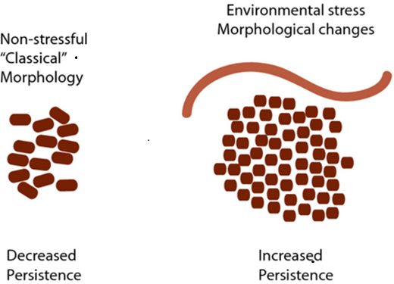
Example of a culture differentiation

Slide 32
Fed-batch Fermentation
Similar to batch culture, but do not operate as closed systems.
At a given point during the fed-batch process one or more substrates, nutrients, and/or inducers are introduced into the bioreactor.
Fed-batch cultures can be run in different ways, e.g. at fixed volume or at a variable volume
This feeding strategy allows the organism to grow at the desired specific growth rate, minimizing the production of unwanted by-products, and allowing the achievement of high cell densities and product concentrations.

Slide 33
Fed-batch Fermentation
Practical Fermentation Technology, McNeil & Harvey John Wiley & Sons

Slide 34
Feeding regimes in fed-batch processes
intermittent
variable
continuous
incremental
Practical Fermentation Technology, McNeil & Harvey John Wiley & Sons

Slide 35
Feeding regimes in fed-batch processes
Practical Fermentation Technology, McNeil & Harvey John Wiley & Sons

Slide 36
Fed-batch Fermentation
Advantages:
Controlling the concentration of the limiting substrate prevents the repressive effects of high substrate concentration and avoids catabolite repression.
By careful feeding strategy the organism’s growth rate and subsequent oxygen demand can be controlled.
High cell density (up to ten times greater) can be achieved by use of fed-batch over batch culture.
Increased production of non-growth-related secondary metabolites.
Reduction of broth viscosity.

Slide 37
Fed-batch Fermentation
Disadvantages:
Detailed knowledge of the organism’s growth and product formation pattern is required, especially when no feedback loop is used.
Deficiency of reliable online sensors for accurate substrate determination in near real time.
Without feedback control, the feed is predetermined and therefore does not allow for any fluctuations within the bioprocess.
The process operator must be fully trained and highly skilled.

Slide 38
Continuous Fermentation
Continuous cultivation is a method of prolonging the exponential phase
Steady state process with less fluctuation in nutrients, cell number or biomass.
The organisms are fed with fresh nutrients, and spent medium and cells are removed from the system at the same rate.
Several factors remain constant throughout the fermentation, such as, culture volume, biomass or cell number, product and substrate concentrations, pH, temperature and dissolved oxygen.

Slide 39
Continuous Fermentation
Practical Fermentation Technology, McNeil & Harvey John Wiley & Sons

Slide 40
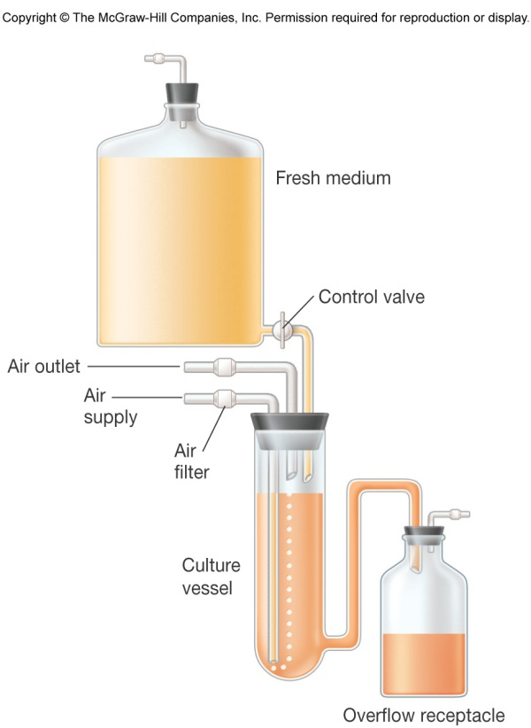
Control Techniques for Continuous Culture – The chemostat
Rate of incoming medium = rate of removal of medium from vessel
An essential nutrient is in limiting quantities
Microbiology McGrow Hill

Slide 41
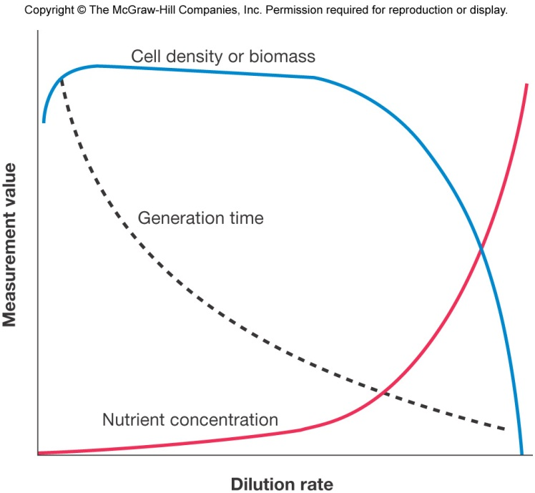
Control Techniques for Continuous Culture – The chemostat
Figure 7.23
Microbiolgogy McGrow Hill

Slide 42
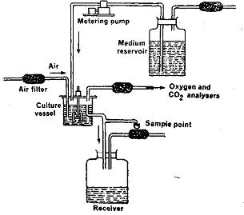
Control Techniques for Continuous Culture – The turbidstat
Regulates the flow rate of media through vessel to maintain a predetermined turbidity or cell density
Dilution rate varies
No limiting nutrient
Turbidostat operates best at high dilution rates
http://www.gitam.edu/eresource/environmental/em_maruthi/growth.htm

Slide 43
Continuous Fermentation
Advantages:
Productivity and growth rate can be optimized by changing the feed flow rate during production
Longer periods of productivity with less down time.
It can take advantage of cell immobilization, which allows the maintenance of high cell concentrations in the bioreactor at low substrate concentrations.
The effects of environmental or physical factors are more easily analyzed in a continuous system
Evolution in these cultures can be readily studied.

Slide 44
Continuous Fermentation
Disadvantages:
The US Food and Drug Administration (FDA) does not accept continuous culture in the production of therapeutic products as a Current Good Manufacturing Practice (cGMP). Why?
Not all products are produced optimally in continuous processes
Contamination can be a major problem in continuous cultivation
Culture mutation can easily occur in continuous processes, often resulting in the micro- organism ‘shedding’ genes required for product formation, or in the case of genetically engineered organisms, a ‘back mutation’ can occur, causing the slower-growing recombinant population to wash out of the vessel.

Slide 45
Submerged vs. Solid-substrate Fermenters
Sanjai Saxena, Applied Microbiology

Slide 46
Submerged Fermenters
Sanjai Saxena, Applied Microbiology

Slide 47
Solid-substrate Fermentation
Solid-substrate fermentations are normally multistep processes, involving:
Pretreatment of a substrate that often requires mechanical, chemical or biological processing
Hydrolysis of primarily polymeric substrates, e.g. Polysaccharides and proteins
Utilization of hydrolysis products
Separation and purification of end-products

Slide 48
Solid-substrate Fermenters
Tray fermenter
Packed bed reactor
Sanjai Saxena, Applied Microbiology

Slide 49
Solid-substrate Fermenters
Stirred drum bioreactors
Gas–solid and stirred bed reactors
Sanjai Saxena, Applied Microbiology

Slide 50
Solid-substrate Fermentation

Slide 51
Upstream & Downstream Processing
Upstream processing (USP) involves:
Microorganism preparation
Fermentation media preparation
The fermentation process

Slide 52
Upstream & Downstream Processing
Upstream processing (USP) involves:
Microorganism preparation
Fermentation media preparation
The fermentation process
Downstream processing (DSP)
All processes following the fermentation.
It has the primary aim of efficiently, reproducibly and safely recovering the target product to the required specifications
Maximize recovery yield and minimize costs

Slide 53
Upstream & Downstream processing
Upstream processing (USP) involves:
Microorganism preparation
Fermentation media preparation
The fermentation process
Downstream processing (DSP)
All processes following the fermentation.
It has the primary aim of efficiently, reproducibly and safely recovering the target product to the required specifications
Maximize recovery yield and minimize costs

Slide 54
Industrial Microbiology: An Introduction

Slide 55
USP

Slide 56
DSP

Slide 57
DSP

Slide 58
DSP

Slide 59
DSP

Slide 60
DSP

Slide 61
DSP

Slide 62
DSP

Slide 63
DSP

Slide 64
DSP

Slide 65
DSP
Industrial Microbiology: An Introduction

